Slide 1


^{COMPUTEROME 2.0}
^{USERS WORKSHOP}
CENTER FOR HEALTH DATA SCIENCE (HEADS)
FACULTY OF HEALTH AND MEDICAL SCIENCES,
UNIVERSITY OF COPENHAGEN, FEBRUARY, 2021

Slide 2
^{PART5}
QUEUING SYSTEM AND BATCH J BS

Slide 3
WHAT HAVE YOU LEARNED SO FAR?
C2 ARCHITECTURE
LOGGING IN
Basic commands, navigation, …
INTERACTIVE JOBS
Load modules, commands
BATCH JOBS
OPTIMIZING JOBS ON C2

Slide 4
Batch jobs are resource provisions that run applications on nodes away from the user and do not require supervision or interaction.
Batch jobs are commonly used for applications that run for long periods of time or require little to no user input.
Batch jobs are created from a job script which provide resource requirements and commands for the job.
BATCH JOBS
XXX

Slide 5




BATCH JOBS
XXX

Slide 6
Batch System + Compute Nodes
Resource requirements and commands
BATCH JOBS
Output of commands, ready to eat
XXX

Slide 7


INTERACTIVE JOBS VS BATCH JOBS
Interactive Job:
One at a time*
Need to keep track of job
Cannot do other things*
Batch Job:
Many at a time
Batch system can keep track of jobs
Live life to the fullest

Slide 8
HOW DO I RUN BATCH JOBS? - qsub command
… a job script which provide resource requirements and commands for the job …
Running a batch job is easy:
c
qsub [options] myScript.sh
c

Slide 9
#! /bin/bash ### Account information #PBS -W group_list=ku_fa -A ku_fa ### Job name #PBS -N jobName ### Error stream #PBS -e myError.err ### Output stream #PBS -o myOut.log ### Resource requirements #PBS -l nodes=1:ppn=40,mem=50gb,walltime=1:00:00 ### Working directory #PBS -d workingDirectory ### Mail on failure #PBS -m n ### Load modules module load xxx/version module load yyy/version
### Run your jobs Job1 Job2 ...
TEMPLATE SCRIPT

Slide 10
#! /bin/bash ### Account information #PBS -W group_list=ku_fa -A ku_fa ### Job name #PBS -N jobName ### Error stream #PBS -e myError.err ### Output stream #PBS -o myOut.log ### Resource requirements #PBS -l nodes=1:ppn=40,mem=50gb,walltime=1:00:00 ### Working directory #PBS -d workingDirectory ### Mail on failure #PBS -m n ### Load modules module load xxx/version module load yyy/version
### Run your jobs Job1 Job2 ...
SHEBANG LINE
BATCH SYSTEM SPECIFICATIONS, RECOURCES, …
TEMPLATE SCRIPT
MODULE LOADS
COMMANDS!

Slide 11
Let us break it down:
#! /bin/bash ### Account information #PBS -W group_list=ku_fa -A ku_fa ### Job name #PBS -N jobName ### Error stream #PBS -e myError.err ### Output stream #PBS -o myOut.log ### Resource requirements #PBS -l nodes=1:ppn=40,mem=50gb,walltime=1:00:00 ### Working directory #PBS -d workingDirectory ### Mail on failure #PBS -m n
Which account should be charged for the job?
Required!
BATCH SYSTEM SPECIFICATIONS

Slide 12
Let us break it down:
#! /bin/bash ### Account information #PBS -W group_list=ku_fa -A ku_fa ### Job name #PBS -N jobName ### Error stream #PBS -e myError.err ### Output stream #PBS -o myOut.log ### Resource requirements #PBS -l nodes=1:ppn=40,mem=50gb,walltime=1:00:00 ### Working directory #PBS -d workingDirectory ### Mail on failure #PBS -m n
Name of the job. Optional - by default the name of the script.
BATCH SYSTEM SPECIFICATIONS

Slide 13
Let us break it down:
#! /bin/bash ### Account information #PBS -W group_list=ku_fa -A ku_fa ### Job name #PBS -N jobName ### Error stream #PBS -e myError.err ### Output stream #PBS -o myOut.log ### Resource requirements #PBS -l nodes=1:ppn=40,mem=50gb,walltime=1:00:00 ### Working directory #PBS -d workingDirectory ### Mail on failure #PBS -m n
BATCH SYSTEM SPECIFICATIONS
Error and output files:
Optional- if not specified, derived from job name.
Error: jobname.ejob_id
Output: jobname.ojob_id

Slide 14
Let us break it down:
#! /bin/bash ### Account information #PBS -W group_list=ku_fa -A ku_fa ### Job name #PBS -N jobName ### Error stream #PBS -e myError.err ### Output stream #PBS -o myOut.log ### Resource requirements #PBS -l nodes=1:ppn=40,mem=50gb,walltime=1:00:00 ### Working directory #PBS -d workingDirectory ### Mail on failure #PBS -m n
BATCH SYSTEM SPECIFICATIONS
Error and Resource requirements
Multiple different resources specified on the same line.
Required!

Slide 15
Let us break it down:
#! /bin/bash ### Account information #PBS -W group_list=ku_fa -A ku_fa ### Job name #PBS -N jobName ### Error stream #PBS -e myError.err ### Output stream #PBS -o myOut.log ### Resource requirements #PBS -l nodes=1:ppn=40,mem=50gb,walltime=1:00:00 ### Working directory #PBS -d workingDirectory ### Mail on failure #PBS -m n
Three resources have to be specified for a job to run on C2:
Number of nodes and cores per node: nodes=1:ppn=40 1 node and 40 cores
Amount of memory: mem=50gb 50 GB of RAM
Time allotment for the job:
walltime=1:00:00 1 hour (dd:hh:mm:ss)
BATCH SYSTEM SPECIFICATIONS

Slide 16
Let us break it down:
#! /bin/bash ### Account information #PBS -W group_list=ku_fa -A ku_fa ### Job name #PBS -N jobName ### Error stream #PBS -e myError.err ### Output stream #PBS -o myOut.log ### Resource requirements #PBS -l nodes=1:ppn=40,mem=50gb,walltime=1:00:00 ### Working directory #PBS -d workingDirectory ### Mail on failure #PBS -m n
BATCH SYSTEM SPECIFICATIONS
Working directory where the job should be run.
Optional - by default your home directory.

Slide 17
Let us break it down:
#! /bin/bash ### Account information #PBS -W group_list=ku_fa -A ku_fa ### Job name #PBS -N jobName ### Error stream #PBS -e myError.err ### Output stream #PBS -o myOut.log ### Resource requirements #PBS -l nodes=1:ppn=40,mem=50gb,walltime=1:00:00 ### Working directory #PBS -d workingDirectory ### Mail on failure #PBS -m n
BATCH SYSTEM SPECIFICATIONS
Get email on failure to complete job.
Optional.

Slide 18
MORE BATCH SYSTEM OPTIONS
#PBS -j oe Merge the output and error stream into one stream - the output stream.
#PBS -k oe Merge the output and error stream into one stream - the output stream -
with continuously updated streams in your home directory.
#PBS -V
Transfer environmental variables to compute node
- not recommended for non-experts.

Slide 19
MORE BATCH SYSTEM OPTIONS EXAMPLE SCRIPT
#! /bin/bash #PBS -W group_list=ku_fa -A ku_fa #PBS -N canid1Map #PBS -e canid1.err #PBS -o canid1.log #PBS -l nodes=1:ppn=40,mem=50gb,walltime=1:00:00 #PBS -d /home/projects/C2_test
### Load modules module load bwa/0.7.15 module load samtools/1.9 module load htslib/1.9
### Run your jobs bwa mem -t 40 refgenome/canFam31.fasta Canid1.R1.fastq.gz > Canid1.sam samtools view -b Canid1.sam > Canid1.bam samtools index Canid1.bam

Slide 20

WHAT ORDER DO THE JOBS GET LAUNCHED IN?
ⓘ Start presenting to display the poll results on this slide.

Slide 21
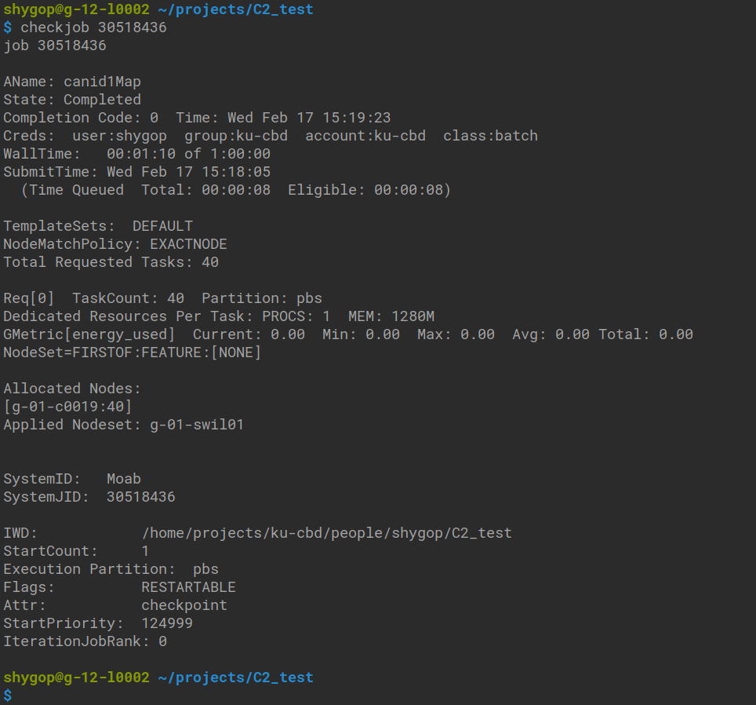
Checkjob job_id
HOW DO I MONITOR MY JOBS?

Slide 22
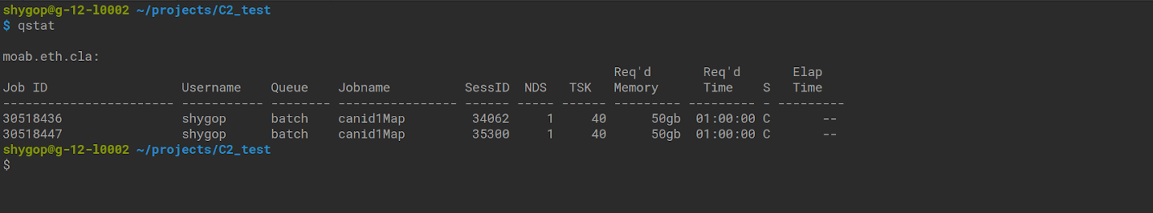
HOW DO I MONITOR MY JOBS?
qstat

Slide 23
EXERCISE TIME - LET’S RUN A JOB
c
Canid1.R1.fastq.gz > Canid1.sam samtools view -b Canid1.sam > Canid1.bam samtools index Canid1.bam #PBS -e canid1.err
#! /bin/bash #PBS -W group_list=ku_fa -A ku_fa #PBS -N canid1Map #PBS -e canid1.err #PBS -o canid1.log #PBS -l nodes=1:ppn=40,mem=50gb,walltime
#PBS -d /home/projects/C2_test
### Load modules module load bwa/0.7.15 module load samtools/1.9 module load htslib/1.9 ### Run your jobs bwa mem -t 40 refgenome/canFam31.fasta
c

Slide 24
OTHER WAYS TO LAUNCH JOBS: IN LINE PBS OPTIONS
#! /bin/bash ### Load modules module load bwa/0.7.15 module load samtools/1.9 module load htslib/1.9 ### Run your jobs bwa mem -t 40 refgenome/canFam31.fasta Canid1.R1.fastq.gz > Canid1.sam samtools view -b Canid1.sam > Canid1.bam samtools index Canid1.bam
qsub -W group_list=ku_fa -A ku_fa -N canid1Map -e canid1.err -o canid1.log -l nodes=1:ppn=40,mem=50gb,walltime=1:00:00 -d /home/projects/C2_test mapCanid2.sh

Slide 25
OTHER WAYS TO LAUNCH JOBS: IN LINE PBS OPTIONS
echo “#! /bin/bash
### Load modules
module load bwa/0.7.15
module load samtools/1.9
module load htslib/1.9
### Run your jobs
bwa mem -t 40 refgenome/canFam31.fasta Canid1.R1.fastq.gz > Canid1.sam
samtools view -b Canid1.sam > Canid1.bam
samtools index Canid1.bam
” | qsub -W group_list=ku_fa -A ku_fa -N canid1Map -e canid1.err -o canid1.log -l nodes=1:ppn=40,mem=50gb,walltime=1:00:00 -d /home/projects/C2_test

